Slide 1
Discrete Fourier Transform
Prof. Amlan Chakrabarti
University of Calcutta

Slide 2
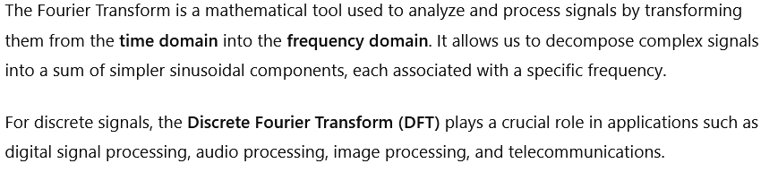
Introduction to Fourier Transform

Slide 3
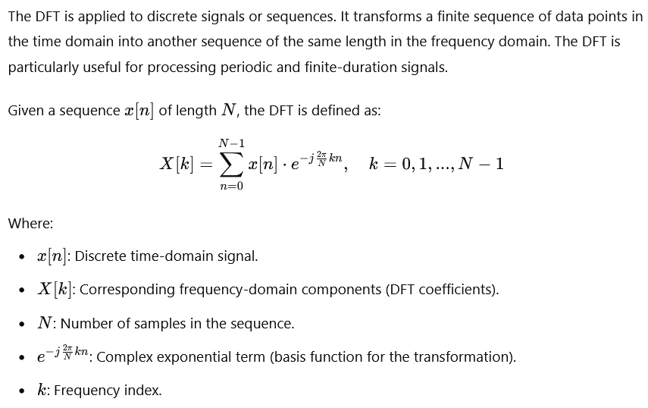
Discrete Fourier Transform (DFT)

Slide 4
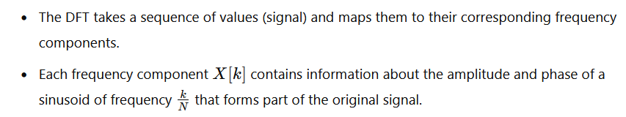

Slide 5
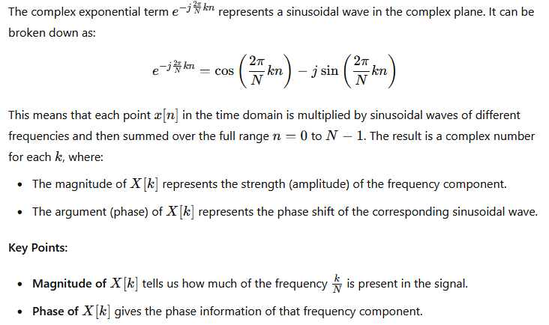
Understanding the DFT Formula

Slide 6
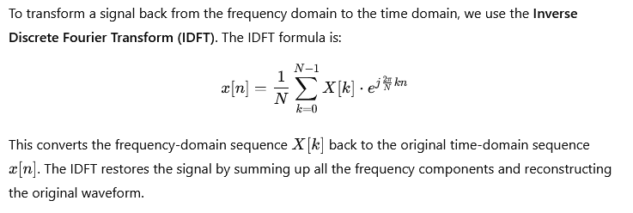
Inverse Discrete Fourier Transform (IDFT)

Slide 7
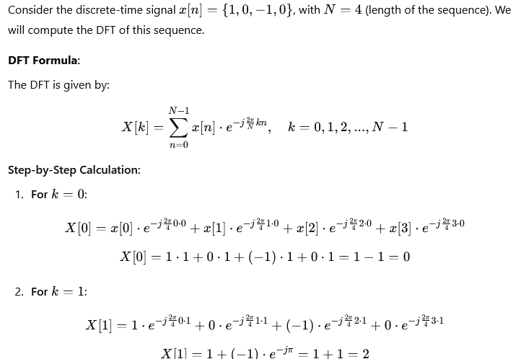
Simple DFT of a Sequence

Slide 8
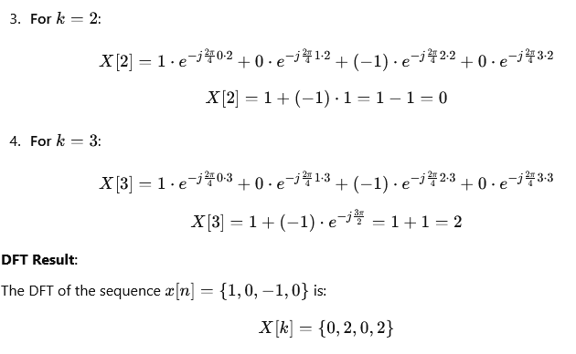

Slide 9
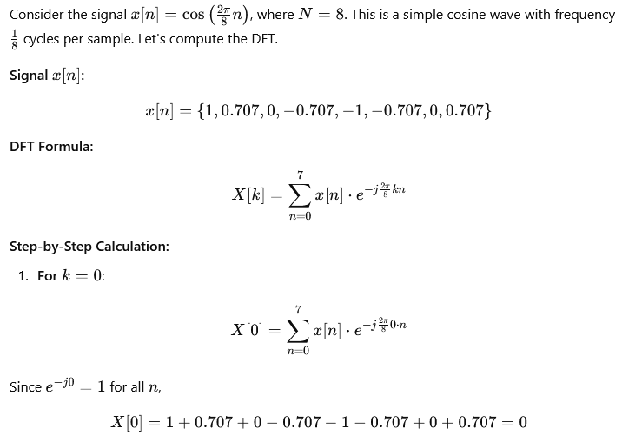
DFT of a Cosine Wave

Slide 10
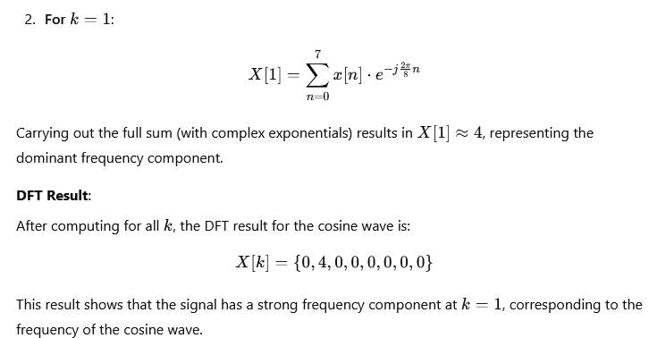

Slide 11
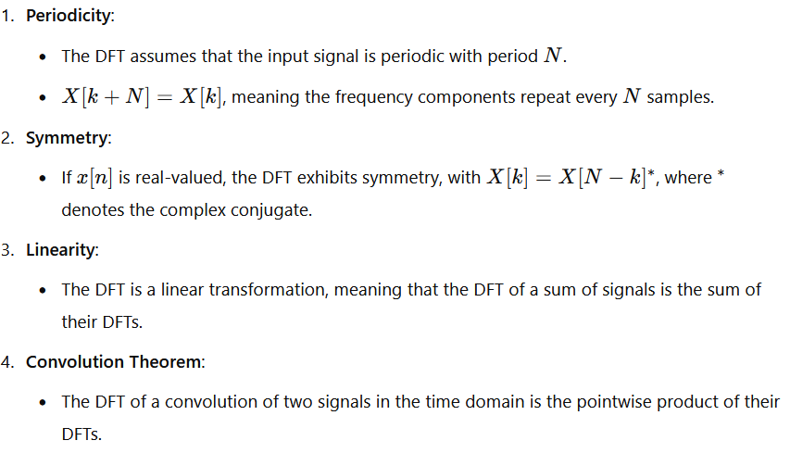
Properties of the DFT

Slide 12
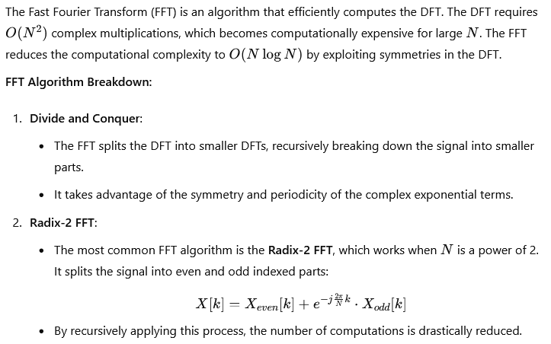
Fast Fourier Transform

Slide 13
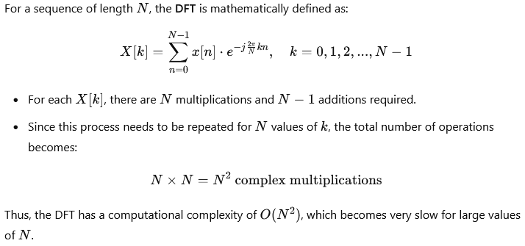
Computational Complexity of DFT

Slide 14
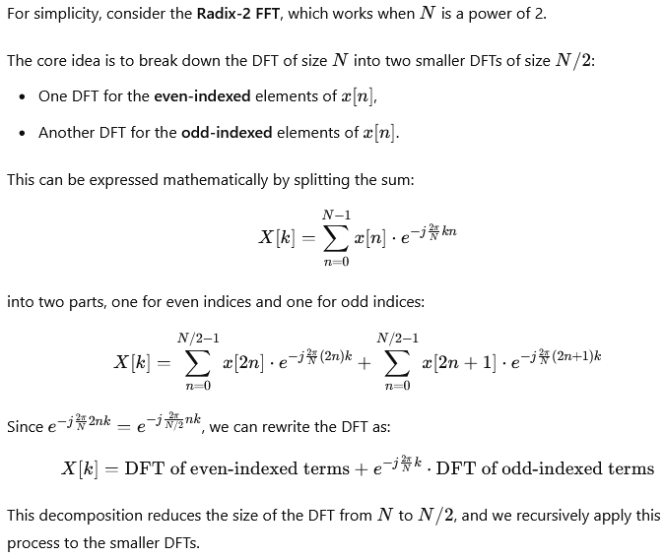
FFT: Divide-and-Conquer Approach

Slide 15
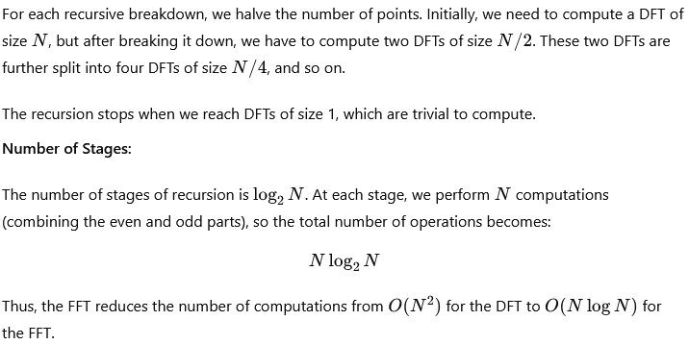
FFT: Recursive Breakdown

Slide 16
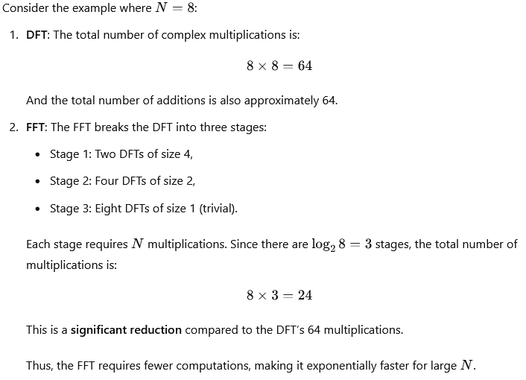
Mathematical Insight into the Efficiency

Slide 17
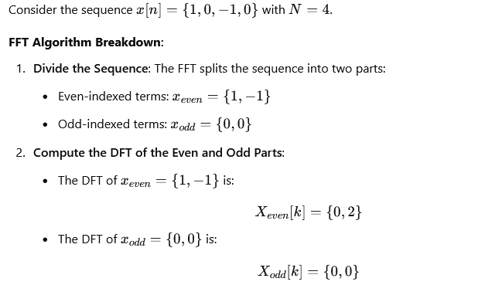
FFT of a Simple Sequence

Slide 18
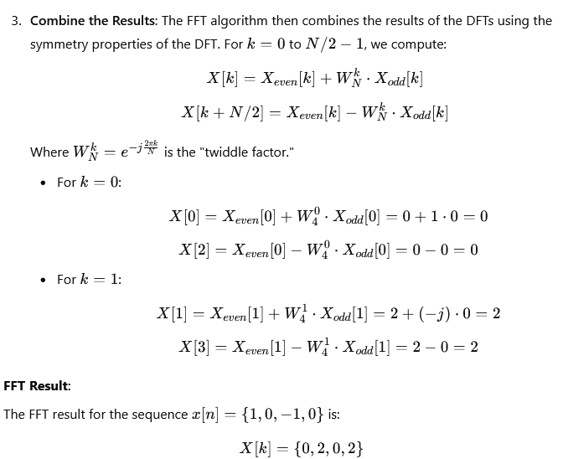

Slide 19
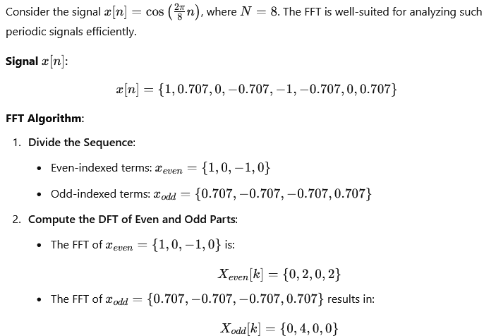
FFT of a Cosine Wave

Slide 20
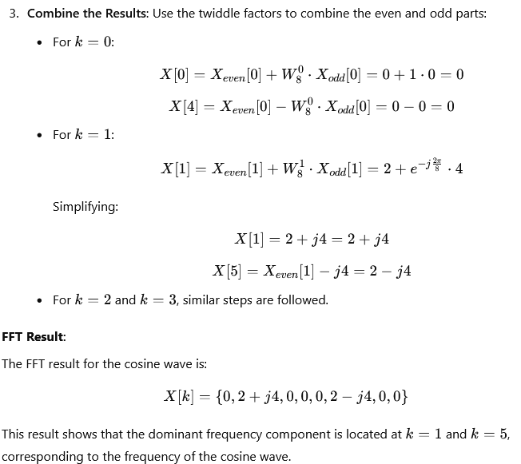

Slide 21
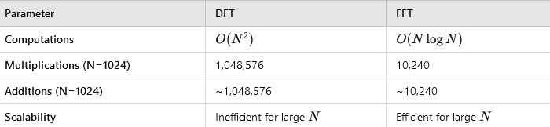
FFT vs DFT: Efficiency Breakdown

Slide 22
More for Study

Slide 23
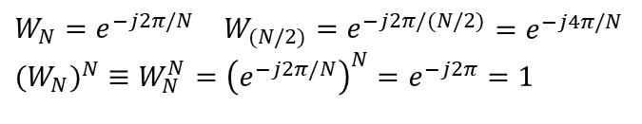
The Discrete Fourier Transform
Recall our definition for the Discrete Fourier Transform (DFT):
The computation for X_{k} requires N² complex multiplications that require four multiplications of real numbers per complex multiplication.
The Fast Fourier Transform (FFT) is an approach to reduce the computational complexity that produces the same result as a DFT (same result, significantly fewer multiplications).
To simplify notation, define:
We can rewrite the DFT equations:
$$\begin{matrix}W_{N}=e^{−j2π/N} & W_{(N/2)}=e^{−j2π/(N/2)}\end{matrix}=e^{−j4π/N} \\ (W_{N})^{N}≡W_{N}^{N}={\left(e^{−j2π/N}\right)}^{N}=e^{−j2π}=1$$
Notes:
]i=k,

Slide 24
Decimation in Time (Radix 2)
Let’s explore an approach that subdivides time interval into successively smaller intervals. Assume N, the size of the DFT, is an even integer so that N/2 is also an integer. Define two auxiliary signals:
Let A_{k} and B_{k} denote two (N/2)-point DFTs of a[n] and b[n]:
We can show that these are related to the DFT by the following equations:
The computation of A_{k} and B_{k} each requires (N/2)² = N²/4 multiplications. The scaling by requires N/2 additional multiplications. The total computation is N²/2+N/2 multiplications, which represents N²/2-N/2 fewer multiplications than the N² multiplications required by the DFT.
For N = 128, this is a savings of 8,128 multiplications (16,384 vs. 8,256).

Slide 25
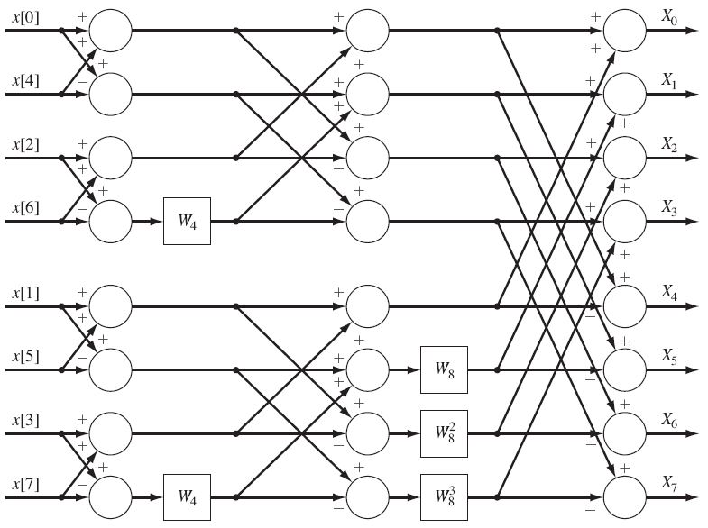
Block Diagram of an FFT Algorithm
If N is a power of 2 (e.g., N = 2^{q}), we can repeat this process to further reduce the computations. The overall complexity reduces from N² to (Nlog₂N)/2.

Slide 26
Bit Reversing
Note that the inputs have been shuffled so that the outputs are produced in the correct order.
This can be represented as a bit-reversing process:
Time Point (n) | Binary Word | Reversed-Bit Word | Order
0 | 000 | 000 | x[0]
1 | 001 | 100 | x[4]
2 | 010 | 010 | x[2]
3 | 011 | 110 | x[6]
4 | 100 | 001 | x[1]
5 | 101 | 101 | x[5]
6 | 110 | 011 | x[3]
7 | 111 | 111 | x[7]

Slide 27
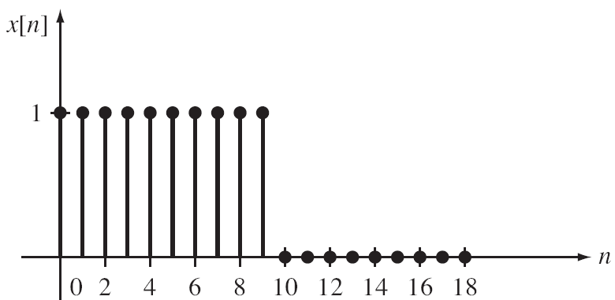
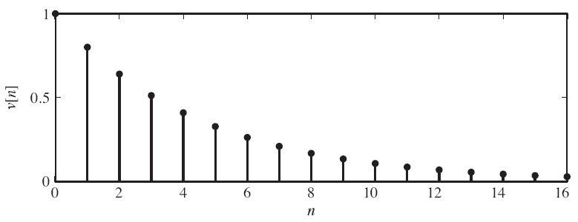
Application – Convolution
Given two time-limited signals:
let r equal the smallest possible integer such that N + Q < 2r. Let L = 2r.
We can pad these signals with zeros to make them the same length so that we can apply an FFT:
The convolution of these two (zero-padded) signals computed using a convolution sum requires L² /2 + 3L/2 multiplications. Computing the convolution using the FFT requires (3L/2)log₂L + L multiplications.
Example: Consider the convolution of a pulse and a truncated exponential.
What is the effect of truncating the exponential in the frequency domain?

Slide 28
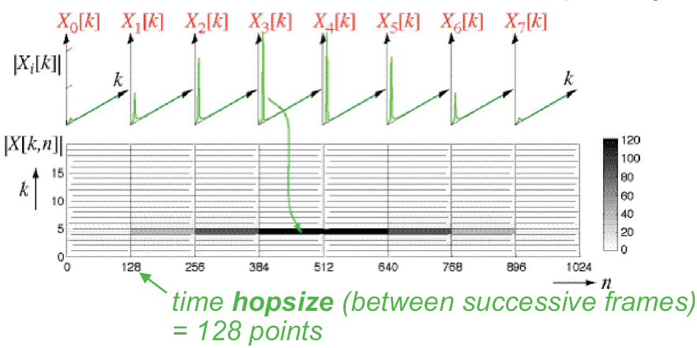
Applications of the FFT – The Spectrogram
Another very important visualization tool is the spectrogram, a time-frequency plot of the spectrum in which the spectral magnitude is plotted as a grayscale value or color.

Slide 29
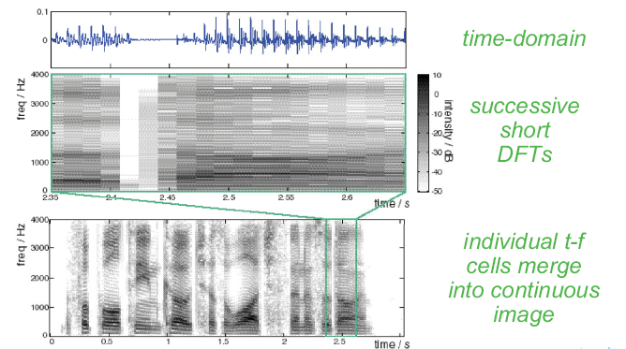
Spectrograms As Continuous Images

Slide 30
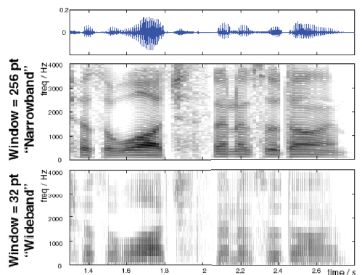
Narrowband vs. Wideband Spectrograms

Slide 31
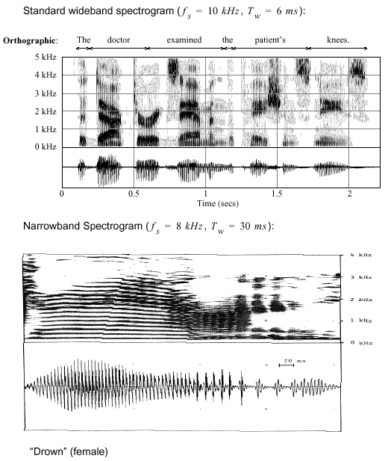
Applications to Speech Processing
The choice of the length of the FFT can produce dramatically different views of your signal.
For speech signals, a 6 ms window (48 samples at 8 kHz) allows visualization of individual speech sounds (phonemes).
A longer FFT length (240 samples – 30 ms at 8 kHz) allows visualization of the fundamental frequency and its harmonics, which is related to the vibration of the vocal chords.
Such time-frequency displays need not be limited to the Fourier transform. For example, wavelets are a popular alternative.

Slide 32

Thank You

